Slide 1
TAS - Evaluating Scientific Impact
Gregor von Laszewski and Fugang Wang
The TAS Team
NSF - October 7
Effort total: 0.6FTE

Slide 2
Why Evaluate Scientific Impact?
RESOURCES
Large computing facilities, such as XSEDE, provide large scale resources to users to advance science
IMPACT
Is there some way to provide an indication about the impact of providing such facilities?
What is the impact of scientific research of individual user, project, or field of study
EVALUATION OF POLICIES
What is the relationship to allocation and funding?
When evaluating a proposal request (requesting resource allocation), what is the criteria to judge whether the proposal is potentially leading to good research and broader impact, and how to get metrics to back up this?
Notes:
The three problems mentioned here: XD impact in general (how to justify the funding XD received?); individual impact within XD (how to compare individuals based on XD relevant impact); general achievement/reputation for prospective XD PIs/users

Slide 3
Objectives
Mostly focused on
Peers
Funding Agency
Users
RAC
Leadership
Compare Impact
Of users and projects
with peers from outside XSEDE
Of users and projects
with peers from inside XSEDE
efficiency in community
efficiency within XSEDE
Provide Metrics
Metrics
Provide Data Services
Provide Bibliometric Data Analytics Services
Provide Bibliometric Data Base Mashup
Support Community access
Support Portal Users and XUP team

Slide 4
Background and Related Efforts
Measure an individual’s scientific achievement/impact
Number of publications; metrics like h-index, g-index
The same metrics but based only on recent pubs
Measure a project’s impact in general
nanohub’s citation statistics
Google Scholar
Publish or Perish
IU Scholarometer
Altmetrics
Mostly User Centric
1 entry for von Laszewski!
Our effort is unique to XSEDE
Notes:
What metrics are being used by others to measure researchers; funded projects, etc.
Nanohub:
A ‘citation’ is a published work that cites/refers nanohub site or its related content
Secondary citation is the citation of the above defined ‘citation’
Statistical distributions of the ‘citation’ related data based on different criteria (author’s organization; topic area – research, education, and so on; continent; cited/referred tools/content; cited year; publication type)
Overall secondary citation and h-index computed

Slide 5
Approach
Publication metrics:
Using the publication and citation data to derive measures for scientific output impact
Publication Data outside of XSEDE:
Publication and/or citation data are available via subscribed resources (such as ISI Web of Knowledge) or open access like Google Scholar, Microsoft Academic Search, however they usually don't provide unlimited access or have licensing issues
Publication Data Inside of XSEDE:
Gather the data from users directly. This includes that users declare if a publication is XD related (via the XD portal biblio management feature)
Notes:
Automatic approach – to get the ‘in general’ metrics indicating individual researcher’s achievement.
User provided data – a) via XD portal, XD related publications to compute XD related metrics. The data is very limited since the biblio upload is an optional but not required, and users typically don’t feel motivated to do that. While getting more such data, the XD related metrics would be increasing significantly.
User provided data – b) Based on Google scholar profile id to retrieve the publication list has been done in the proof of concept work. So if the users are providing such information via the XD portal or via POPS as part of the allocation request process, we can try this approach to automatically get user vetted publications list.
Citation data via Google Scholar seems working fine, although quite slowly. In the future this process might be kept running to find citation for new publications; or updating the old data if all completed.

Slide 6
Data Acquired – publication data
Over 140k publications for over 20k XSEDE users
Not user vetted; Not XSEDE specific (important for comparison)
~ 5k confirmed XSEDE supported publications.
User vetted/tagged publication entries
Cross referenced and confirmed with 3rd party services.
There is no equivalent database with this amount of information, we are leading this effort as others have only considered 10’s of users and not 20K. This needs continuous updates
There is no equivalent database that automatically vetted the references

Slide 7
Architecture
Pluggable data sources via mining databases and/or accessing 3rd party service APIs
Mashup database providing common interface to collaborating systems like XDMOD
Service layer and web presentation
Notes:
The 3 highlighted points of the architecture view.

Slide 8
Architecture
IU TAS
Interface
Layer
IU TAS
Database Mashup
REST API
Portal
IU TAS
Service
Layer
IU TAS REST Services
XSEDE
Portal
IU TAS Publications Mashup
IU TAS
Publication
Mashup
NSF Award
DB Mining
3rd Party
Queries
IU NSF Awards
Publication data
for XSEDE Users
3rd Party Data
XD Entities
Mashup
Microsoft Academic Search
Google Scholar (User profiles)
UB TAS Databases &Reports
XSEDE Databases
NSF Database
ISI Web of Science
XDMoD
Warehous
XDcDB Mirror
Publications & Accounts
XSEDE
Quarterly Reports
POPS
Proposal Data
NSF Awards
Original
Data Source
Citeseer, PUBMed, ACM, IEEE, …
Mendeley

Slide 9
XSEDE related Data Acquisition . . . an ongoing process
Publication data:
Automatic approach:
Mining the NSF award data available from NSF;
Mining TeraGrid/XSEDE past quarterly reports (text files in .pdf, .doc, and .docx format);
User submitted publication data via XSEDE User Portal (XUP)
Mashup data from different sources;
Utilizing 3rd party services from Google Scholar, Microsoft Academic Search, etc.;
Requiring user input
User vetting/tagging publications (is it XSEDE supported? Which project?);
Citation data:
Should not be provided by users. Google Scholar and ISI are now being utilized to get the citation data.
annual
quarterly
monthly
instantly
on Demand
on Demand
ongoing

Slide 10
Our effort contributes to 99% of the data
Who has contributed to the data?
Previous TG Study
How and where the TeraGrid supercomputing infrastructure benefits science, Johan Bollen , Geoffrey Fox, Prashant Raj Singhal, DOI: 10.1016/j.joi.2010.09.004, Journal of Informatics, Volume 5, Issue 1, January 2011, Pages 114–121

Slide 11
Ex 1: What kind of projects return the most publications and citations? Impact per Allocation vs Allocations (by projects)
~ 800 Projects involved
What do we learn?
Smaller projects are more efficient?
FOS difference.
Other metrics to be taken into account
A Preliminary ROI indicator?
Note: Based on XSEDE supported publications only (as of Sept 2014).

Slide 12
Ex 1: What kind of projects return the most publications and citations? Impact per Allocation vs Allocations (by projects)
~ 800 Projects involved
What do we learn?
Smaller projects are more efficient?
FOS difference.
Other metrics to be taken into account
A Preliminary ROI indicator?
Note: Based on XSEDE supported publications only (as of Sept 2014).
Are smaller allocations more efficient?

Slide 13
Ex 2: Comparing XSEDE Supported Publications with Peers
~ 1500 XSEDE supported publications appeared in these top 10 journals (by # of XSEDE supported publications published)
Comparing each single publication with all peers appeared in the same issue. Get percentile ranking based on citation data (per ISI Web of Science data).
Percentage of how many belongs to each quarter (top 25% to bottom 25%).
In general trends towards higher quarter.
FOS difference (Physics, Astrophysics, Astronomical; Chemistry; etc.)

Slide 14
Ex 2: Comparing XSEDE Supported Publications with Peers
Conclusion: XSEDE publications tend to be more highly cited than their peers
~ 1500 XSEDE supported publications appeared in these top 10 journals (by # of XSEDE supported publications published)
Comparing each single publication with all peers appeared in the same issue. Get percentile ranking based on citation data (per ISI Web of Science data).
Percentage of how many belongs to each quarter (top 25% to bottom 25%).
In general trends towards higher quarter.
FOS difference (Physics, Astrophysics, Astronomical; Chemistry; etc.)

Slide 15
Summary
Developed automated publication and citation system for XSEDE
Developed method to assess internal XSEDE allocation distribution effectiveness (by allocation size, fos etc.)
Provide Sci Impact analysis of established publications/citations database
Working with XUP to track and curate user publications
Established method to assess external XSEDE effectiveness/ROI
Compare XSEDE citations to non-XSEDE citations within the same journals
Enables data analytics that was not possible before
Allows generalization from XSEDE

Slide 16
Future Plans
Establish routing impact metrics reporting mechanism to be included as part of XSEDE quarterly report.
Complete the ‘my view’ and ‘rapid vetting/tagging’ functionality and deploy to tas.futuregrid.org
Pulling peer publications and carry out statistical analyses.
Investigating how to best interpret the impact metrics of XSEDE as well as individual entities and compare to peers.
Impact based on other criteria in addition to bibliometrics
Usage based (downloading, viewing..)
Altmetrics (reuse of code/data; mention in social network; etc.)

Slide 17
End of main slides

Slide 18
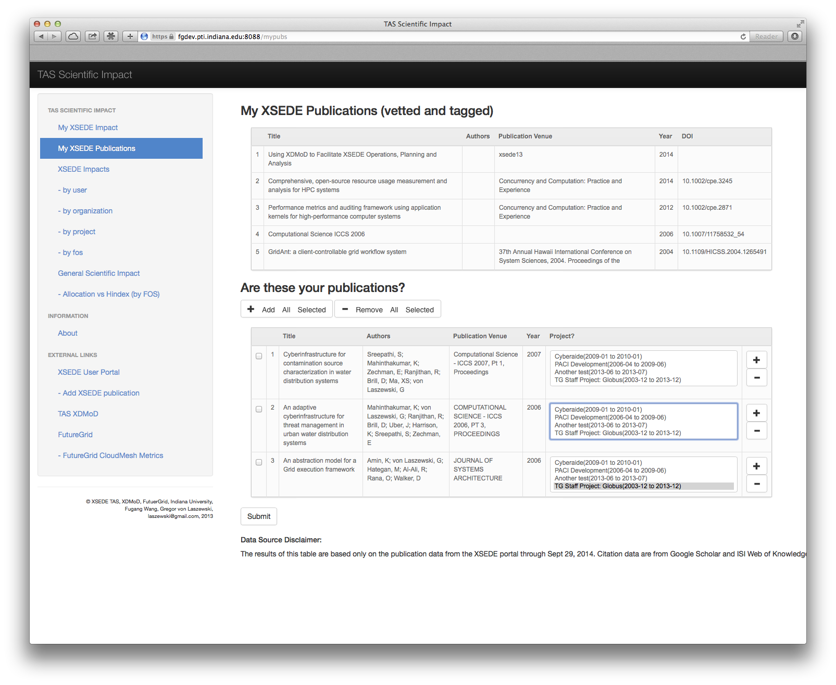
Vetting and Tagging of publications (proposal)
It will be easy with the TAS Web Service to add XSEDE projects to the publications.
Publications can be vetted easily with the click of a button
This could be expanded to include non XSEDE projects
Funding Agencies that may be more fine grained associated than just on the project level.

Slide 19
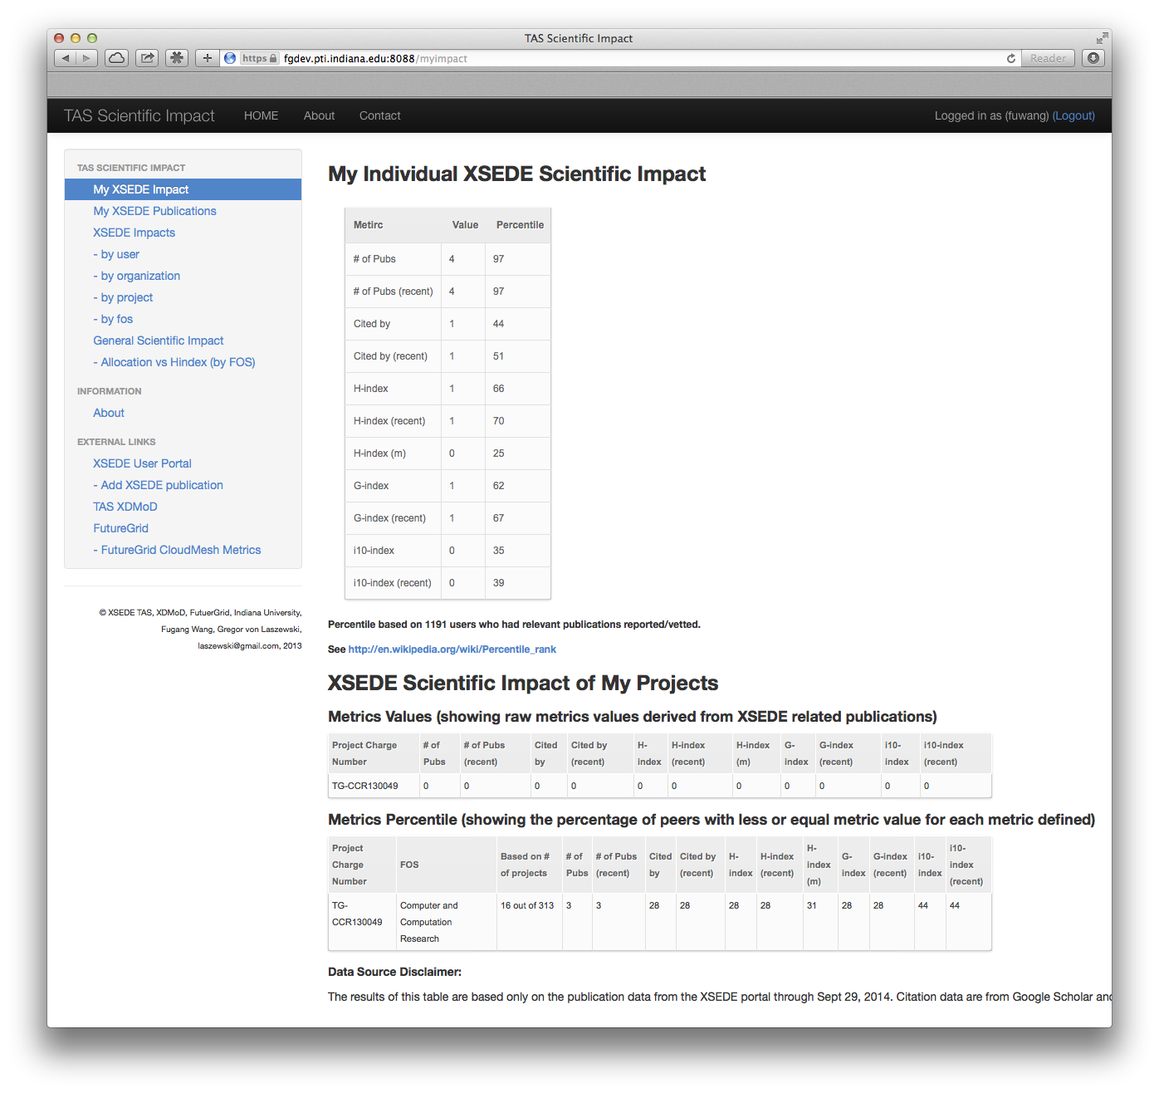
Screenshot
Individual Users can look up their own Metrics.
This includes
User-based
Project-based
Project Ranking
Compares the project against other projects
In Field of Science
Example = 31 % have <= h-index as I have

Slide 20
Metrics
Intuitive Metrics: Number of publications, Number of citations
H-index
Derived based on productivity (quantity of papers published) and impact (based on citation)
h as the max number of papers with citation number higher or equal to h
H-index(m) to compare veteran researchers with junior researchers
G-index
Similar to h-index but it uses average citations so you got rewarded if you have a paper with very high citations
Other Metrics – i10-index (number of publications with at least 10 citations)
Does a researcher keep up with the good research he/she usually does more recently – Metrics from only recent publications

Slide 21
Can we use other data than Google Scholar?
Citation data from ISI for all publications
Citation data from Google Scholar for 33,861 publications
These cover 1462 users
Metrics from Google Data and
ISI data are highly correlated.
So We can use citation data
from either source

Slide 22
Can we use other data than Google Scholar?
Citation data from ISI for all publications
Citation data from Google Scholar for 33,861 publications
These cover 1462 users

Slide 23
Community Ranking
While extrapolating from our rich data sources we conclude that XSEDE as a whole would rank at ~
number 19
of the twenties highly
rated journals in computer science and engineering.
Note:
the data was extrapolated from data that we retrieved from ISI and not Google (licensing issues)
Google published data on only the top 20 publication venues in that field
No one in the community has to our knowledge been able to derive such a statement for XSEDE

Slide 24
Is there a correlation between impact and allocations in FOS level? Impact Metrics vs Allocations
Weak correlation on individual project level (r ~ 0.3), if we compare for all projects (>6k), or based on project types.
On FOS level stronger correlation (r ~ 0.7) (132 FOS) (right figure)
Note: Based on all mined publications
Notes:
Based on all publications mined (not necessarily XD related)
This possibly shows that (general) impact metrics IMPACT the allocations received.

Slide 25
Is there a correlation between impact and allocations in FOS level? Impact Metrics vs Allocations
Weak correlation on individual project level (r ~ 0.3), if we compare for all projects (>6k), or based on project types.
On FOS level stronger correlation (r ~ 0.7) (132 FOS) (right figure)
Note: Based on all mined publications
High positive correlation
Between Scientific Impact and Allocations based on the Field of Science categories
Notes:
Based on all publications mined (not necessarily XD related)
This possibly shows that (general) impact metrics IMPACT the allocations received.

Slide 26
Efficiency comparison of FOS? H-index of FOS vs Allocations
Effect of size of FOS is shown
De-trended plotting
See http://tas.futuregrid.org for an online version.
Note: Based on all mined publications

Slide 27
Efficiency comparison of FOS? H-index of FOS vs Allocations
Effect of size of FOS is shown
De-trended plotting
See http://tas.futuregrid.org for an online version.
Note: Based on all mined publications
Detrended residual study reveals difference between
Field of Sciences

Slide 28
Correlation between impact and allocations in project level (grouped by FOS)? Projects Impact Metrics vs Allocations (by FOS)
A Data point shows the correlation (r) of project level impact metrics vs the allocations for a FOS.
Data point (dot/circle) size proportional to the size (number of projects) of the FOS.
The majority has positive correlation, and some are quite high (FOS difference)
Note: Based on XSEDE supported publications only (as of Sept 2014).
Notes:
Observed: Positive correlation between the impact metrics and the allocation of the field of science
Each dot is a field of science, the size indicates the number of projects in the FOS
X axis is just an index, sorted by descending order of size of field of science
Y axis is correlation coefficient between the impact metrics and the resource allocation

Slide 29
Correlation between impact and allocations in project level (grouped by FOS)? Projects Impact Metrics vs Allocations (by FOS)
Positive correlation exists for
most FOS. I.E., given one FOS,
usually the impact metrics
and the allocations for
projects are positively
correlated.
A Data point shows the correlation (r) of project level impact metrics vs the allocations for a FOS.
Data point (dot/circle) size proportional to the size (number of projects) of the FOS.
The majority has positive correlation, and some are quite high (FOS difference)
Note: Based on XSEDE supported publications only (as of Sept 2014).
Notes:
Observed: Positive correlation between the impact metrics and the allocation of the field of science
Each dot is a field of science, the size indicates the number of projects in the FOS
X axis is just an index, sorted by descending order of size of field of science
Y axis is correlation coefficient between the impact metrics and the resource allocation

Slide 30
What kind of projects return the most publications and citations? Impact per Allocation vs Allocations (by projects)
Smaller Allocations are more
Efficient … (?)
judging by the Metrics used to evaluate.
… but FOS difference should be Considered too.
~ 800 Projects involved
What do we learn?
Smaller projects are more efficient?
FOS difference.
Other metrics to be taken into account
A Preliminary ROI indicator?
Note: Based on XSEDE supported publications only (as of Sept 2014).

Slide 31
What impact do XSEDE publications have in the fields by comparing citations?
Comparing XSEDE Supported Publications with Peers
XSEDE publications tend to
be more highly cited than
their peers!
~ 1500 XSEDE supported publications appeared in these top 10 journals (by # of XSEDE supported publications published)
Comparing each single publication with all peers appeared in the same issue. Get percentile ranking based on citation data (per ISI Web of Science data).
Percentage of how many belongs to each quarter (top 25% to bottom 25%).
In general trends towards higher quarter.
FOS difference (Physics, Astrophysics, Astronomical; Chemistry; etc.)

Slide 32
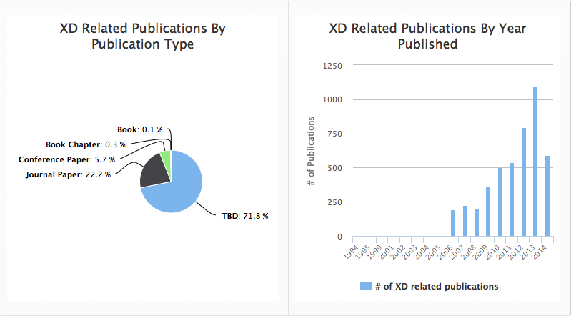
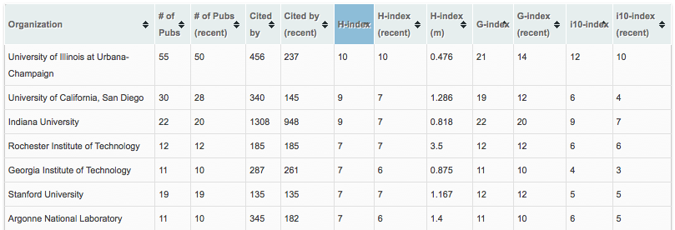
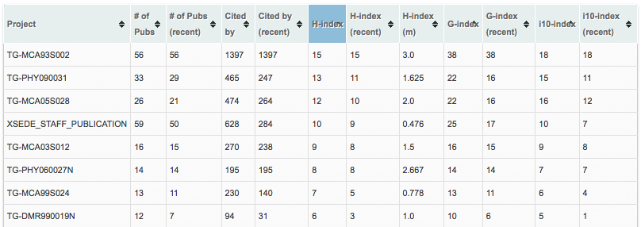
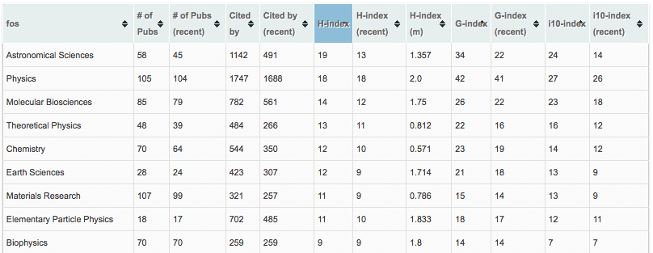
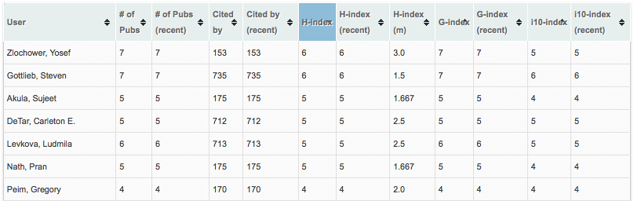
Direct Impact Metrics – (Derived from XSEDE supported publications only)
users with at least one publication where users confirmed authorship
XD users: 1191*
Organizations: 257*
XSEDE projects: 852
Number of publications: 4527
Total citations received from these publications: 91299
(As of Sept 29, 2014)
* Based on user vetted data only
Notes:
The impact metrics data will be updated at end of month, and then this slide will be updated too.
There are total 20K users
From which 1191 have at least one publication

Slide 33
Summary - Individual entities in XSEDE
Impact metrics calculation for individual users, projects, FOS
Based on only XSEDE related publications
Based on all publications we have obtained
The impact metrics viewable from the TAS scientific impact portal as well as from XDMoD
Correlating analyses of impact metrics vs resources allocated
Showing sign of positive correlation
FOS difference
A preliminary indicator of ROI
In progress: Individual user view of the user’s impact metrics and percentile ranking; as well as those for the projects that the user is a PI of.
Active XSEDE users authenticate via oauth for myproxy
Percentile ranking of projects is calculated within the FOS that the project belongs to
Running in the dev/testing portal and ready to deploy to the production TAS scientific impact portal very soon

Slide 34
Summary - XSEDE Supported vs Peers
We have identified the publication venues of XSEDE supported publications, and is devising method to automatically pull publication data from those publication venues as a comparing baseline.
~ 700 publication venues identified
Preliminary results (for the top 10 journals) shows XSEDE supported publications tend to receive higher citations. For certain journals/FOS the effect is very significant.
In the process of obtaining more data and more analyses would be conducted following that.
In general, investigating appropriate way to define the peers and scope for the comparison.

Slide 35
Publications

Slide 36
In most journal issues XSEDE publications count less than 5%, with some number of issues the ratio goes to 5%~10%, while for very few issues (a dozen or so out of the 3.6K issues involved) it has more than 10%.

Slide 37
776 distinct issues had at least one XSEDE publications published (thus, we did ranking in each of them).
The 3.6K number is the total issues from those journals that we had obtained data from.
21 % of all the issues had at least one publication from XSEDE

